Slide 1
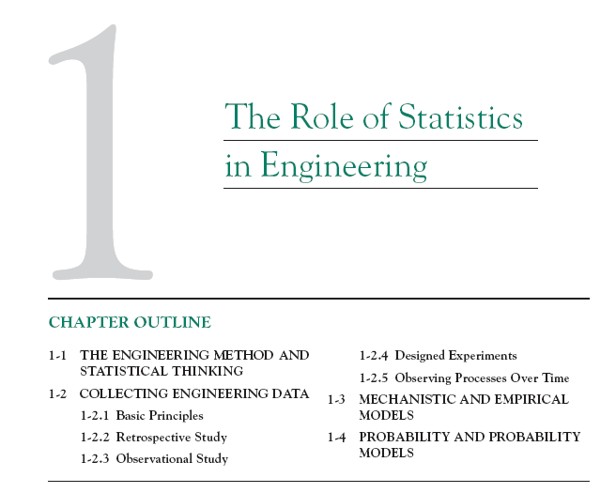

Slide 3
1-1 Statistics in Engineering
An engineer is someone who solves problems of interest to society by the efficient application of scientific principles by
Refining existing products
Designing new products or processes

Slide 4
1-1 Statistics in Engineering
Figure 1.1 The engineering method

Slide 5
1-1 Statistics in Engineering
The field of statistics deals with the collection, presentation, analysis, and use of data to
Make decisions
Solve problems
Design products and processes

Slide 6
1-1 Statistics in Engineering
Statistical techniques are useful for describing and understanding variability.
By variability, we mean successive observations of a system or phenomenon do not produce exactly the same result.
Statistics gives us a framework for describing this variability and for learning about potential sources of variability.

Slide 7
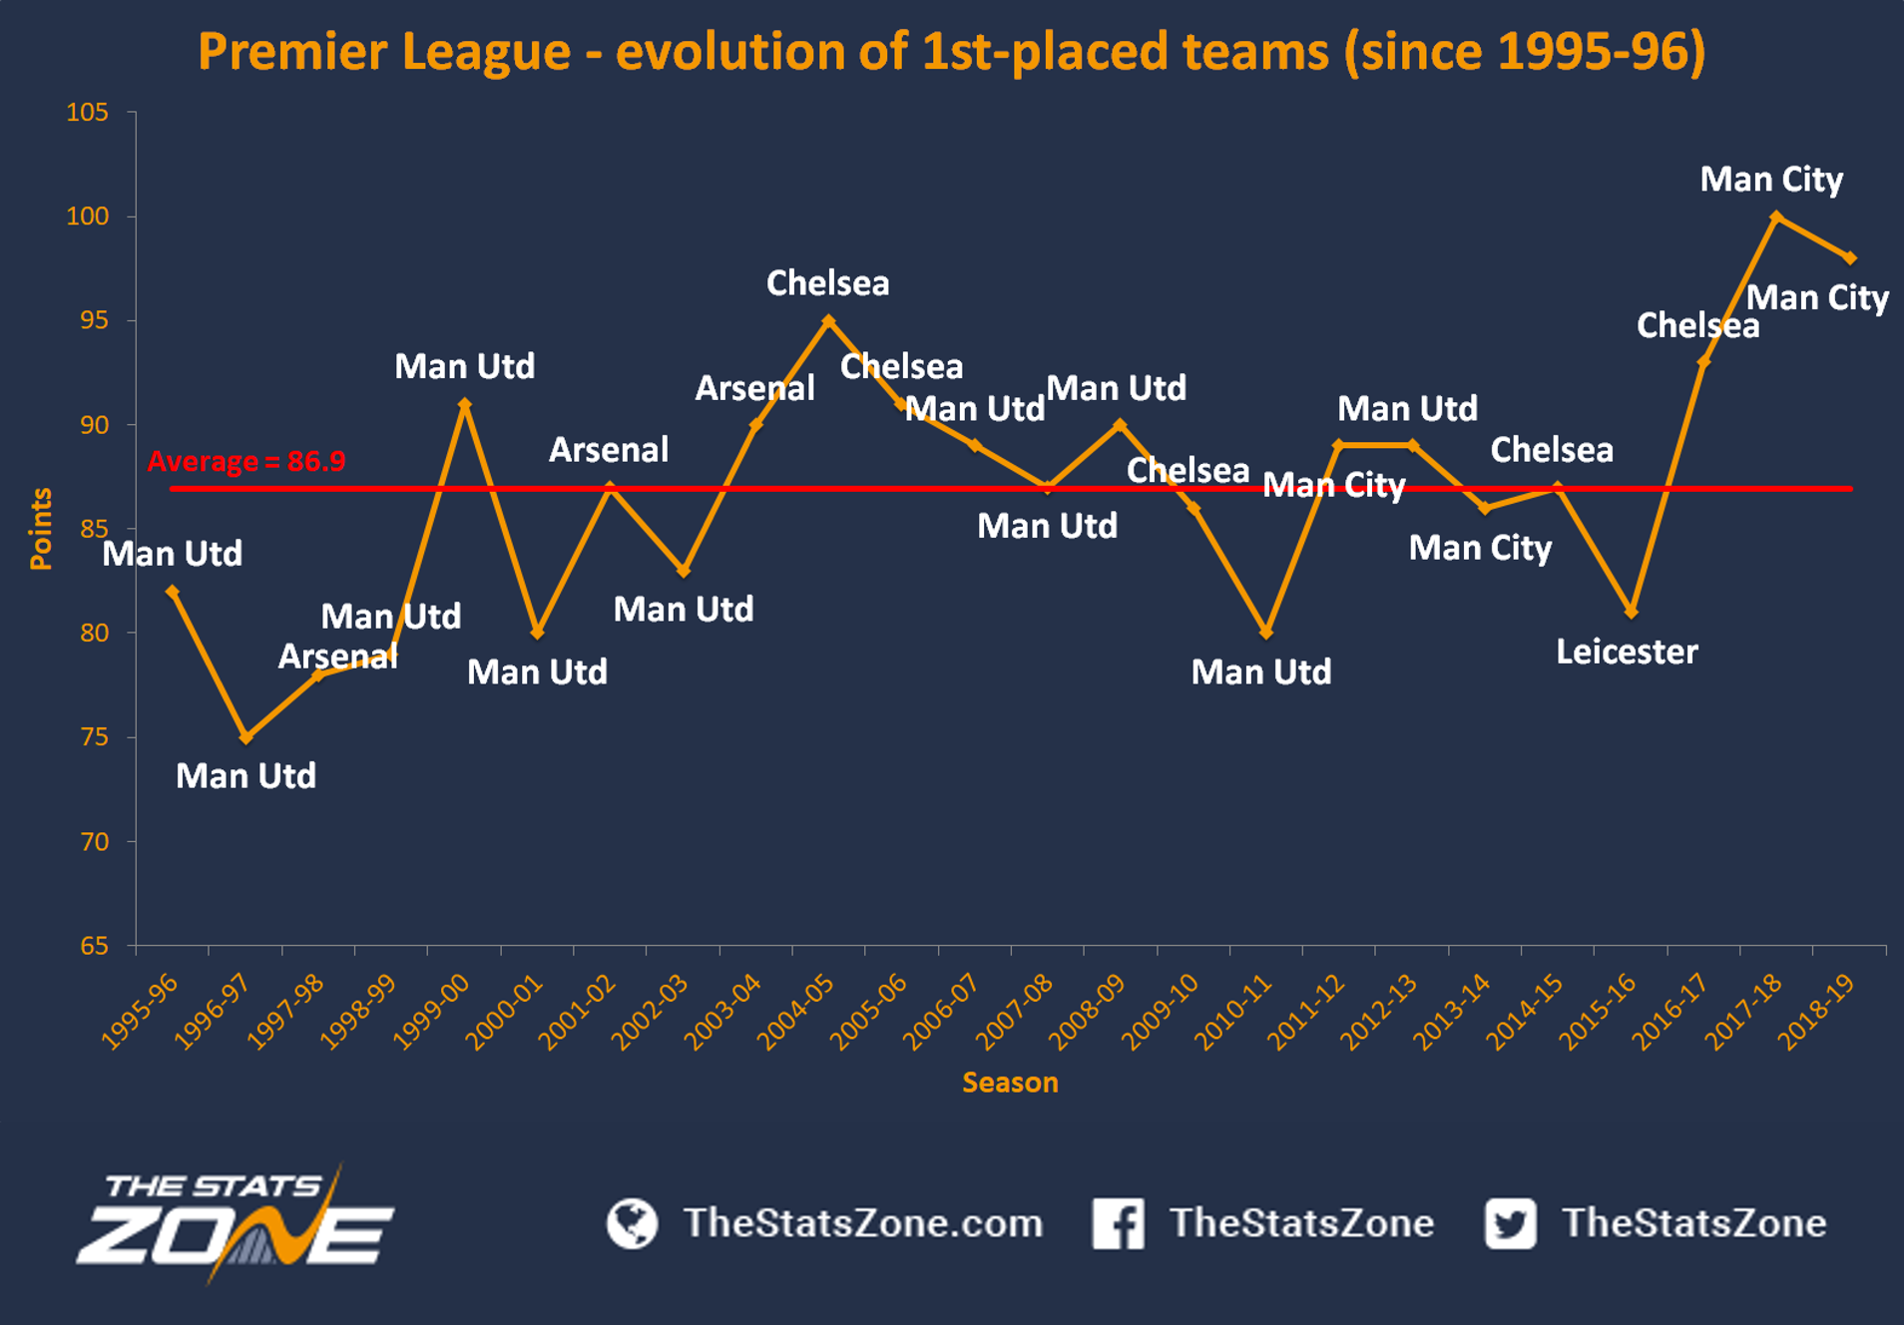

Slide 8
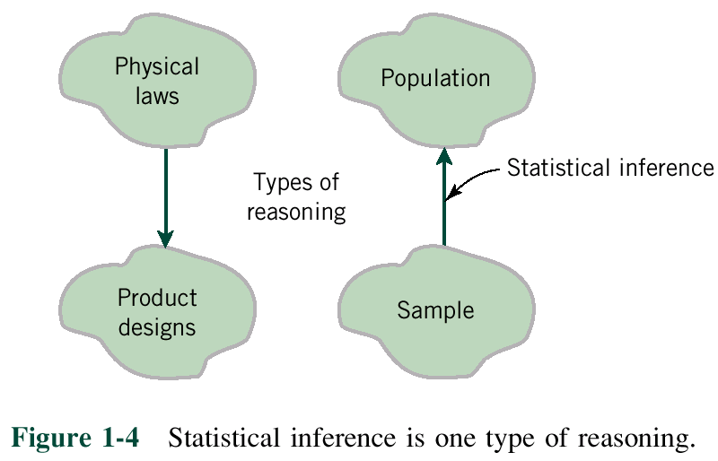
1-1 Statistics in Engineering

Slide 9
1-1 Statistics in Applications
Example
A programmer has two different clever algorithms for one problem. He is not super strong in mathematics, and his algorithms are very complicated, so he cannot analyse theoretically their complexity (as in your MAD101 course). How can he decide which algorithm is better? What’s variability in this problem?

Slide 10
1-1 Statistics in Applications
Example
You want to understand the relationship between having high grades in advanced mathematics and being successful in jobs that do not explicitly use advanced mathematics. How will you find it out? What is the variability here?

Slide 11
1-2 Collecting Engineering Data
Three basic methods for collecting data:
A retrospective study using historical data
An observational study
A designed experiment

Slide 12
1-2 Collecting Engineering Data
Historical data:
Economy of countries in the past
Average age of people over the years
Proportion of students who obtained grade at least 6 in this course in previous years

Slide 13
1-2 Collecting Engineering Data
Observational study:
Number of species on the Earth
Number of customers who buy your product
Stock market

Slide 14
1-2 Collecting Engineering Data
Designed experiments:
Facebook tries to suggest something to you
Studying the runtime of algorithms
Marketing strategies
Physics, Chemistry,...

Slide 15
1-4 Probability and Probability Models
Probability models help quantify the risks involved in statistical inference, that is, risks involved in decisions made every day.
Probability provides the framework for the study and application of statistics.

Slide 16
